Slide 1

BRIGHT
COFFEE
SHOP
Bringing Happiness in Every Cup
+27 79 690 2854
dikenokgolane@gmail.com
October 2025

Slide 2

Content
Data collection
Data analysis techniques
Sales trend
1
Insights
Conclusion
2

Slide 3

Data collection
Collected transaction data from Bright Coffee Shop analysis
Here are the column names used consistency :Product_Category, Unit_Price, Transaction_Qty
Created new variables to support analysis:used arithmetic operators Revenue = Quantity × Unit Price
Extracted time and day information from transaction timestamps to analyse peak sales periods.
03

Slide 4
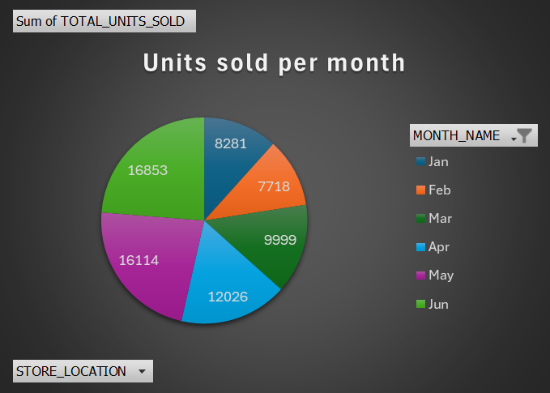
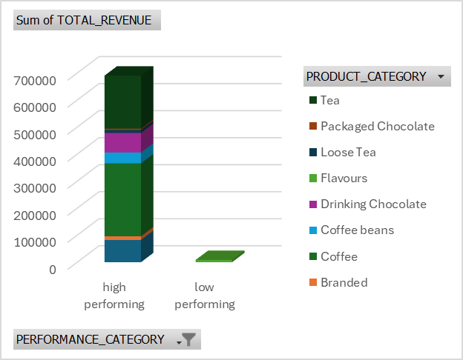
Date analysis techniques
Grouped data using SUM of transaction qty to observe units sold per month and customer buying behavior.
Calculated total and average
revenues to measure profitability and
sales performance across category
Identified top-performing and underperforming items based on total revenue and sales volume.
04

Slide 5
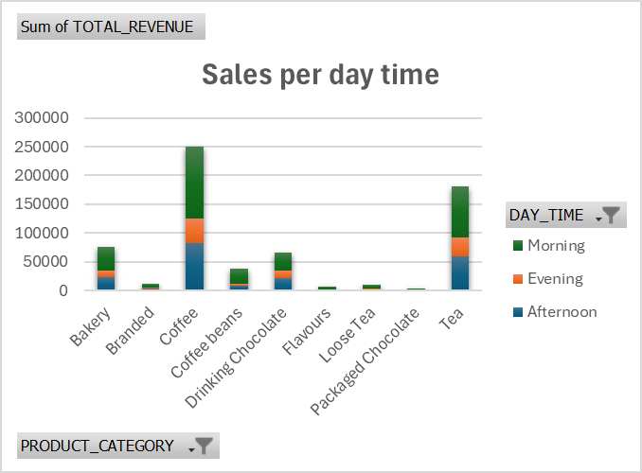
Sales Trend
The chart shows total revenue across different product categories at Bright Coffee Shop during the morning, afternoon, and evening.
• Coffee and Tea generate the highest revenue, especially in the morning, indicating that customers mostly purchase these beverages to start their day.
• Bakery items also perform well in the morning, complementing coffee sales.
• Evening and afternoon sales are noticeably lower across all categories, suggesting less customer traffic during these times.
• Overall, the morning period dominates sales performance, highlighting it as the peak sales time for the shop.
05

Slide 6
Insights
•Bright Coffee Shop demonstrates strong operational performance driven by its beverage and bakery offerings. To sustain growth, the shop should expand high-demand items, introduce seasonal promotions, and rethink underperforming product lines.
• Strengthening the marketing presence of Lower Manhattan and optimising stock levels during peak months will further enhance overall profitability and customer satisfaction.
06

Slide 7
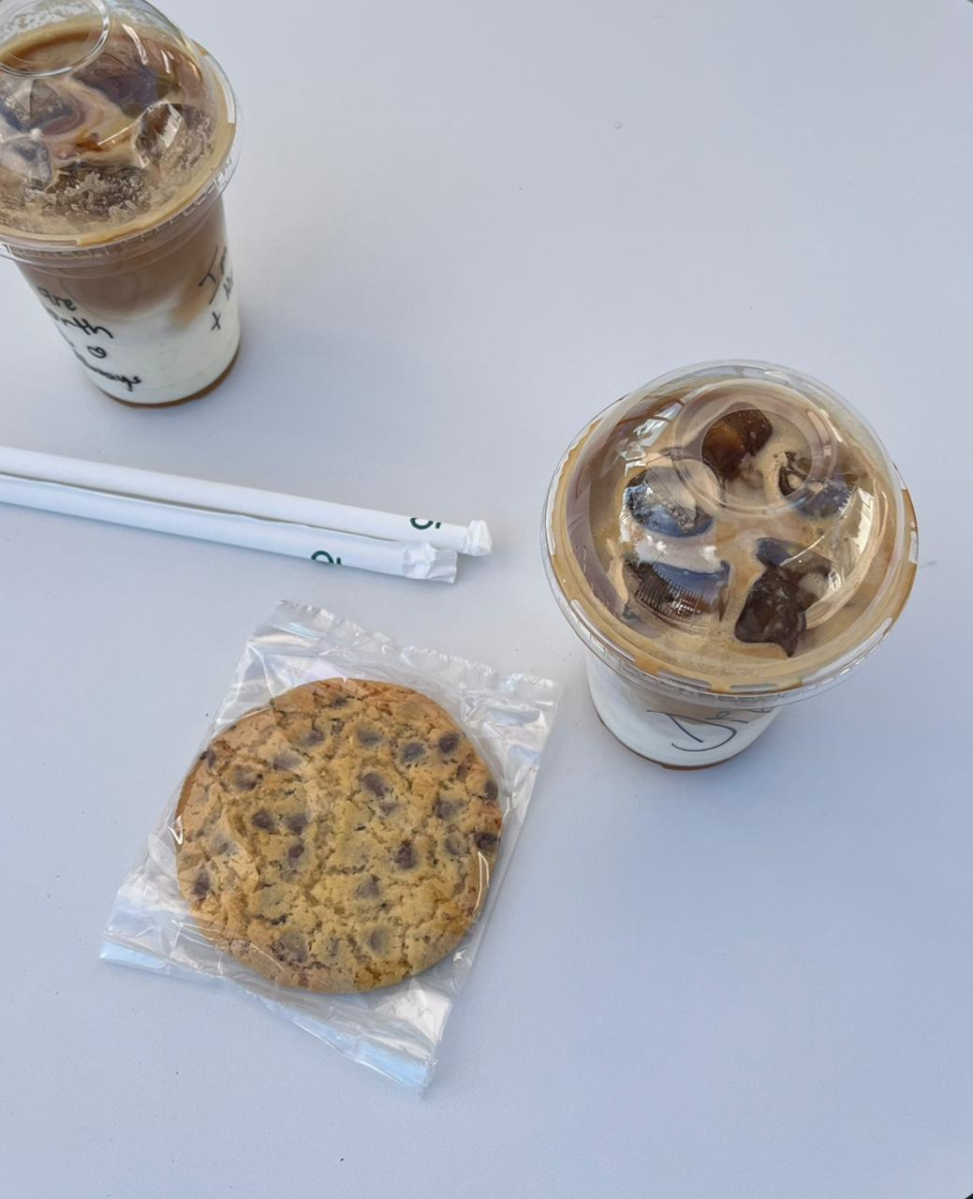

Conclusion
•Bright Coffee Shop shows strong overall performance, led by its coffee and tea. The Hell’s Kitchen branch performs best, while Lower Manhattan offers room for growth. Seasonal trends affect sales, with peaks in June and lower sales in Feb.
•To maintain success, the shop should focus on top-selling items, introduce seasonal promotions, and improve marketing and operations at underperforming branches. These actions will help boost profitability and customer satisfaction.
To
Cup
07

